Slide 1
(PCC) Robot Kinematics and Dynamics
Syllabus Contents:
Basic concepts of linear algebra and feedback control, Rigid bodies and homogeneous transformations, Differential kinematics
Robot modelling, Direct kinematics, Inverse kinematics problem, Inverse kinematics algorithms
Trajectory planning, Kinematic solutions and trajectory planning
Geometric Jacobian / Analytical Jacobian, Singularities and redundancy, Statics and manipulability
INTRODUCTION TO ROBOT DYNAMICS: Forward Dynamics and Inverse Dynamics – Importance – Spatial description and transformations – Different types of dynamic formulation schemes – Lagrangian formulation for equation of motion for robots and manipulators. Properties of the dynamic model, Dynamic model of simple manipulator structures, Dynamic parameters identification, Operational space dynamics model,
DYNAMIC MODELING AND SIMULATION: Modeling of motion of robots and manipulators using Newton – Euler equations – State space representation of equation of motion and system properties – Importance of Simulation and its types –
Numeric Integration solvers and their role in numeric simulation - Numeric simulation of robots and manipulators using MATLAB / Simulink module.
INTRODUCTION TO ROBOT CONTROL: Introduction – Need and types of control schemes for robots – joint space control schemes with an example – task space control schemes with an example.

Slide 2
Basic Concepts

Slide 3
Robotics is concerned with the study of those machines that can replace human beings in the execution of a task, as regards both physical activity and decision making.

Slide 4
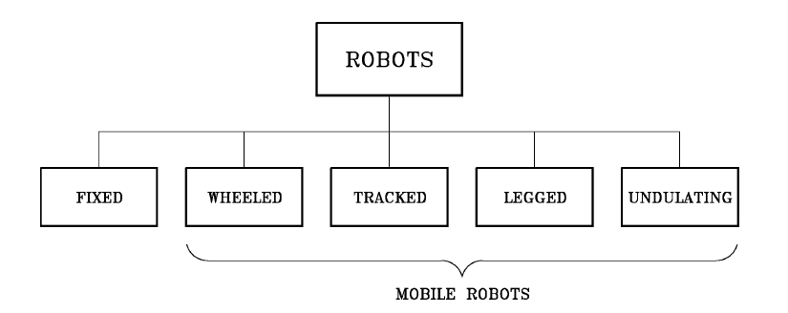
Robot Classification

Slide 5
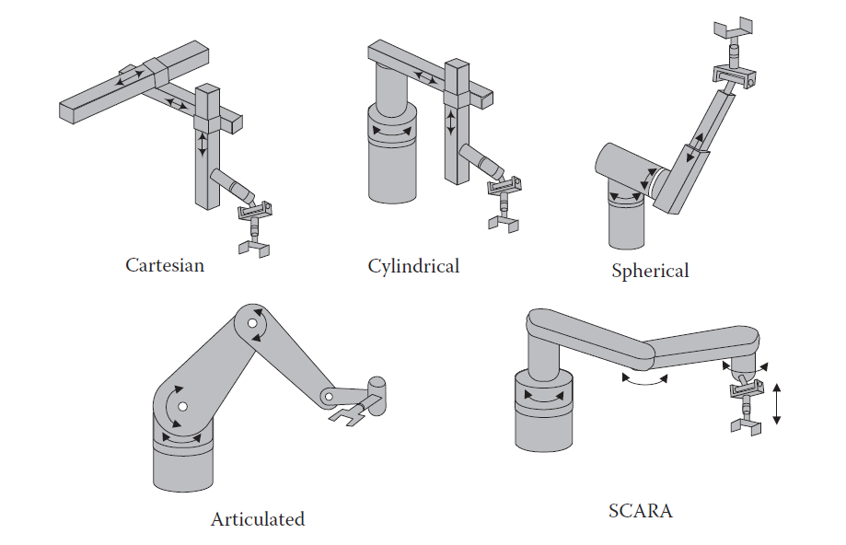
Robot Configurations

Slide 6
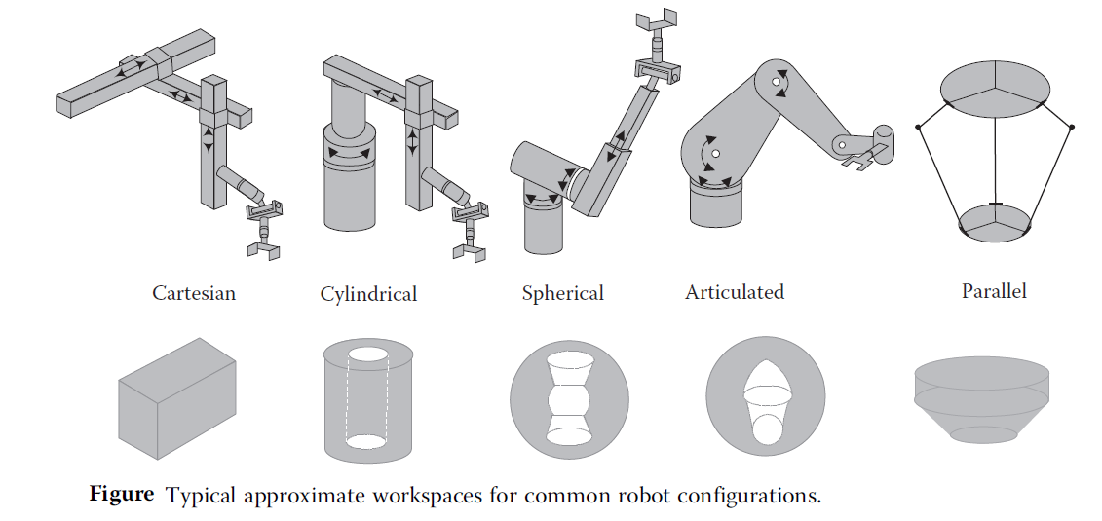
Work space

Slide 7
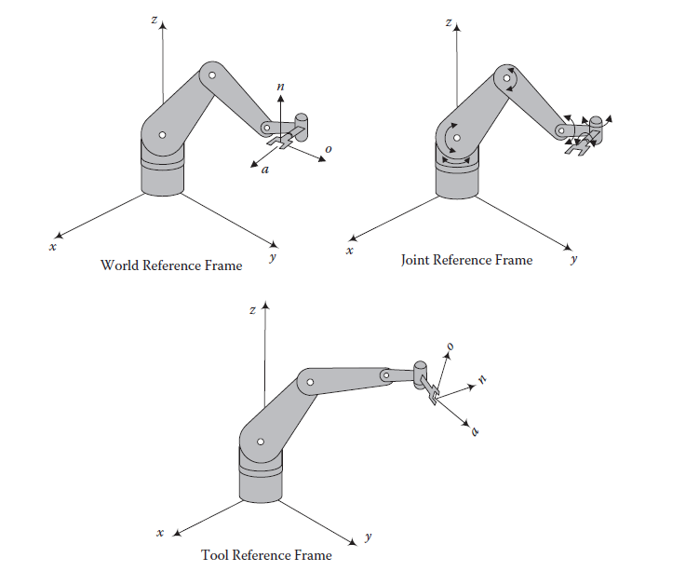
A robot’s World, Joint, and Tool reference frames

Slide 8
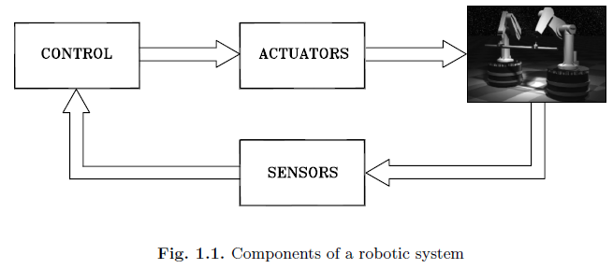
Components of Robotic System

Slide 9
Robot manipulator
The mechanical structure of a robot manipulator consists of a sequence of rigid bodies (links) interconnected by means of articulations (joints);
A manipulator is characterized by an arm that ensures mobility, a wrist that confers dexterity, and an end-effector that performs the task required of the robot.
The fundamental structure of a manipulator is the serial or open kinematic chain. From a topological viewpoint, a kinematic chain is termed open when there is only one sequence of links connecting the two ends of the chain.
Alternatively, a manipulator contains a closed kinematic chain when a sequence of links forms a loop.

Slide 10
Manipulator
A manipulator can be schematically represented from a mechanical viewpoint as a kinematic chain of rigid bodies (links) connected by means of revolute or prismatic joints.
One end of the chain is constrained to a base, while an end-effector is mounted to the other end.
The resulting motion of the structure is obtained by composition of the elementary motions of each link with respect to the previous one.
Therefore, in order to manipulate an object in space, it is necessary to describe the end-effector position and orientation.
The end-effector position and orientation (pose) to be expressed as a function of the joint variables of the mechanical structure with respect to a reference frame.

Slide 11
Rigid body
A rigid body, sometimes called a link, represents a solid body that cannot deform.
The distance between any two points on a single rigid body remains constant.

Slide 12
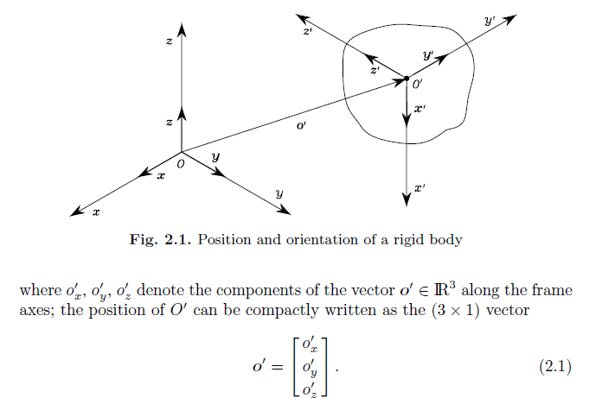
Rigid bodies
A rigid body is completely described in space by its position and orientation (in brief pose) with respect to a reference frame.

Slide 13
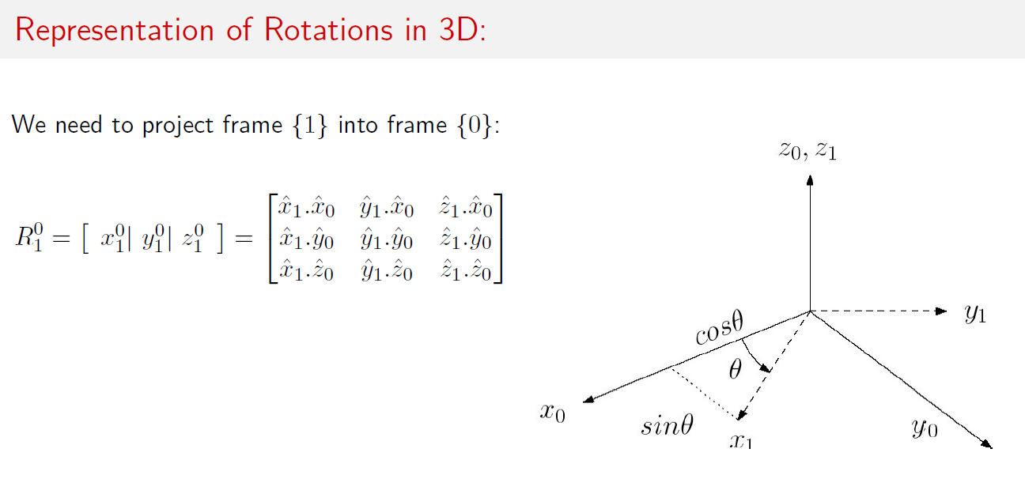
Rotation in 3D

Slide 14
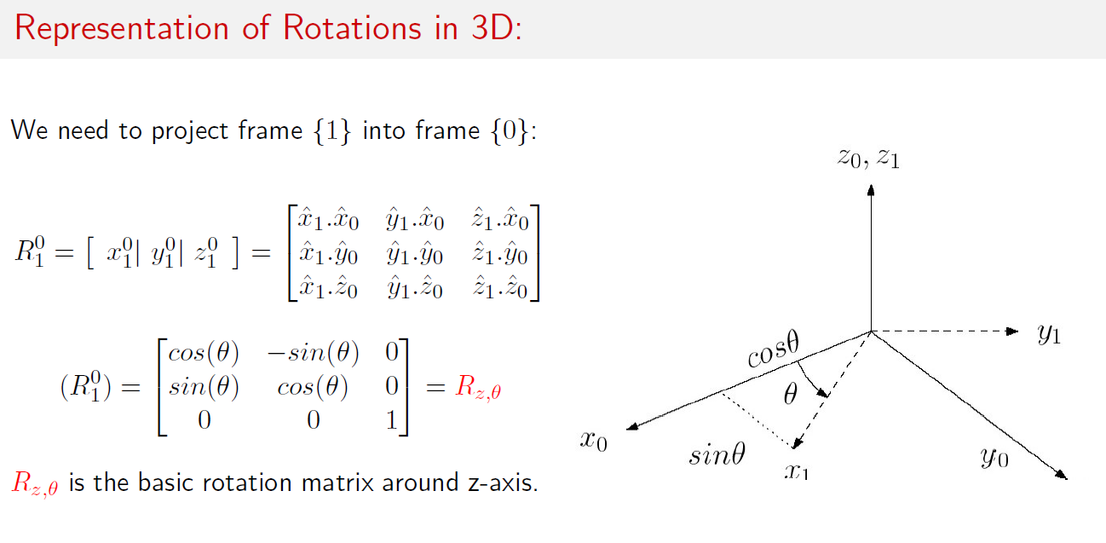
Rotation in 3D

Slide 15
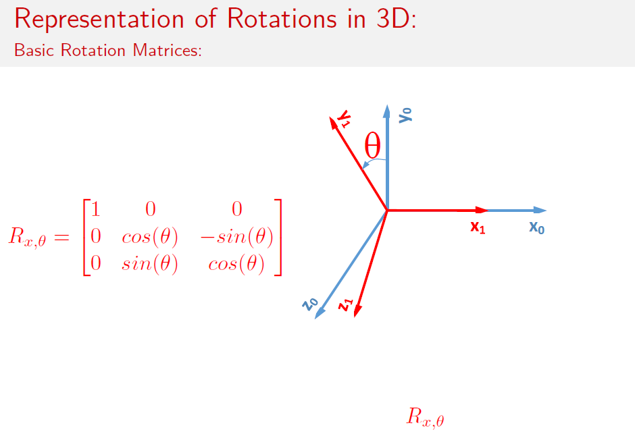
Rotation in 3D

Slide 16
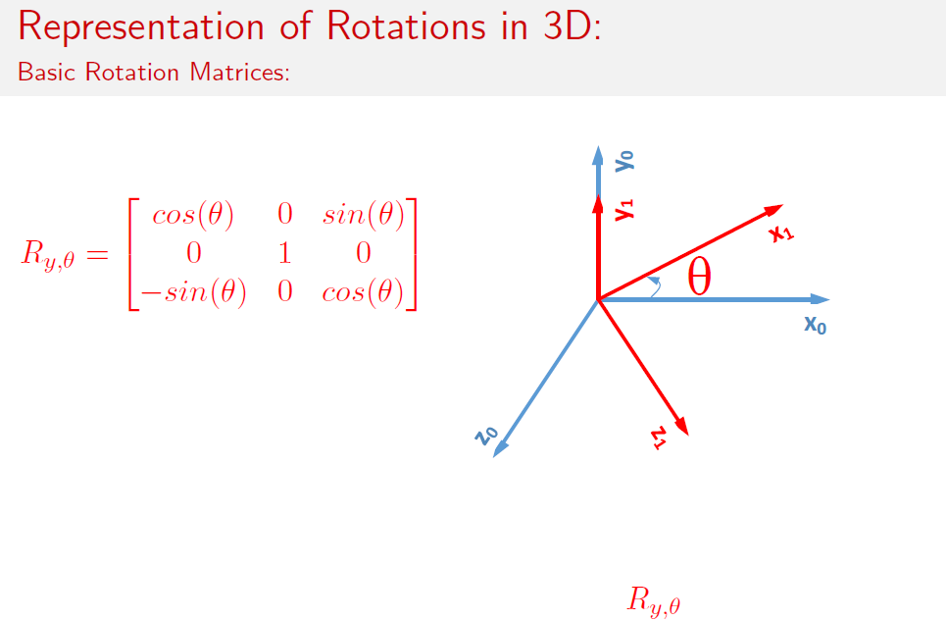
Rotation in 3D

Slide 17
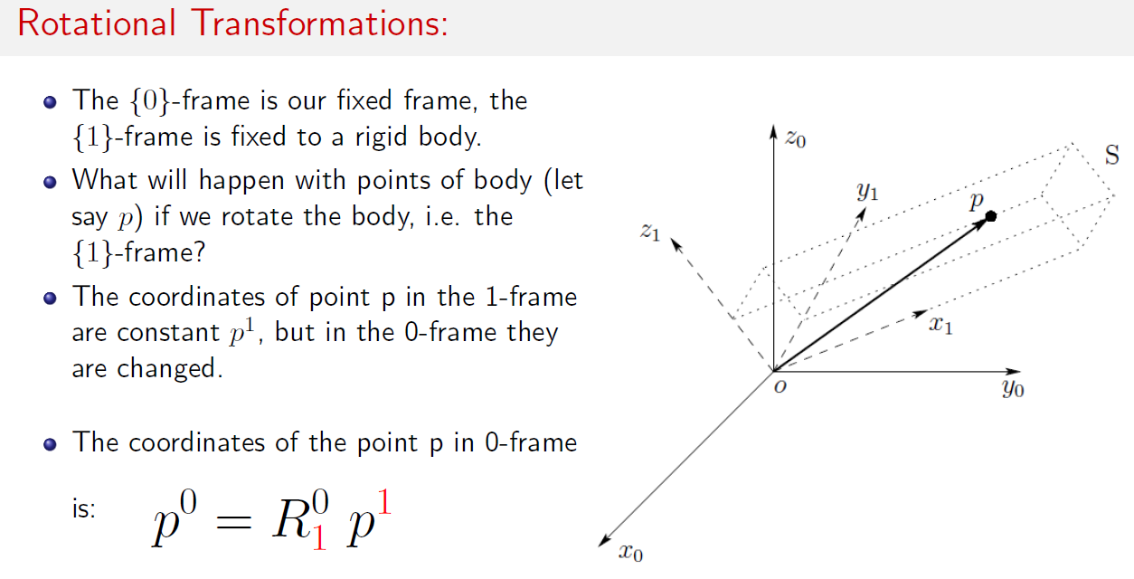
Transformations

Slide 18
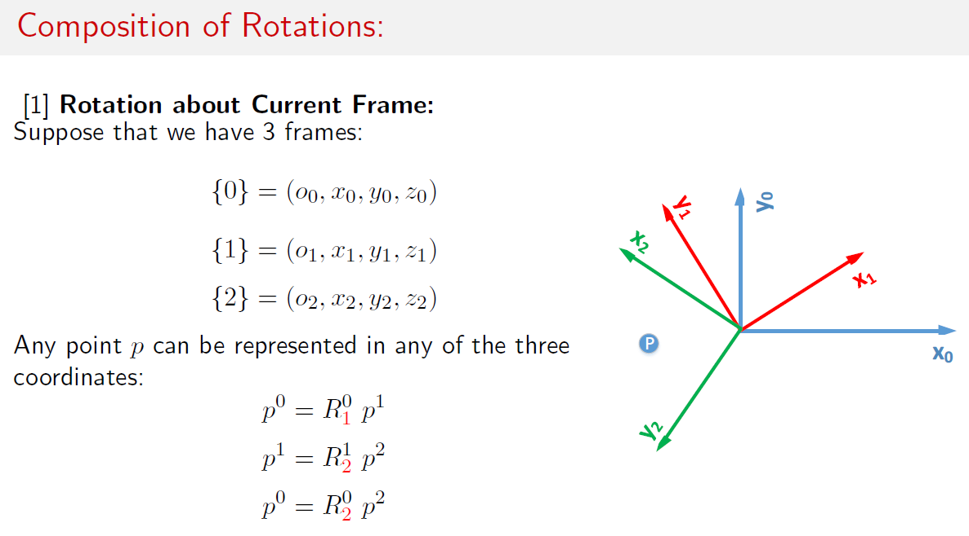
Rotational Transformation

Slide 19
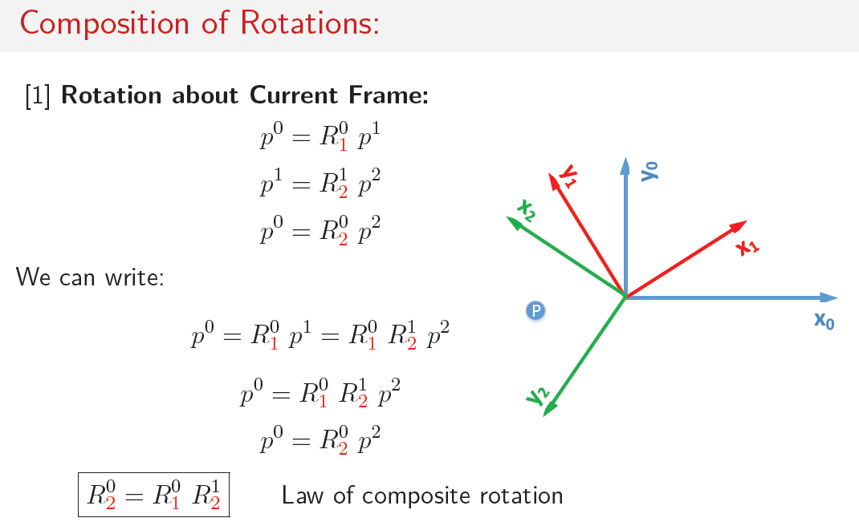
Rotational Transformation

Slide 20
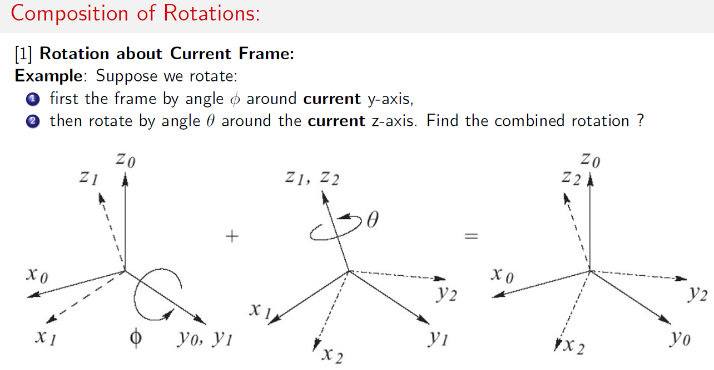
Rotational Transformation

Slide 21
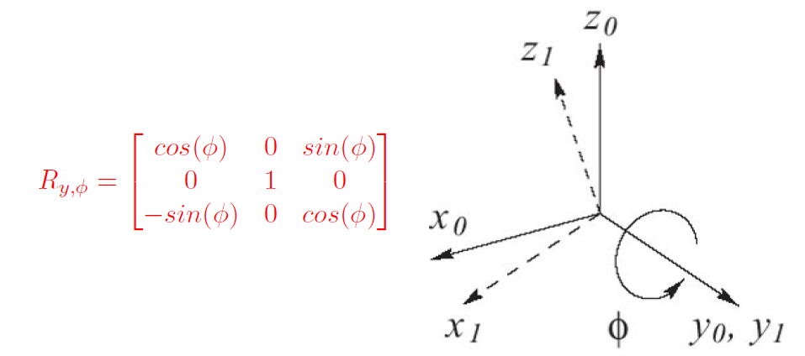
Rotational Transformation

Slide 22
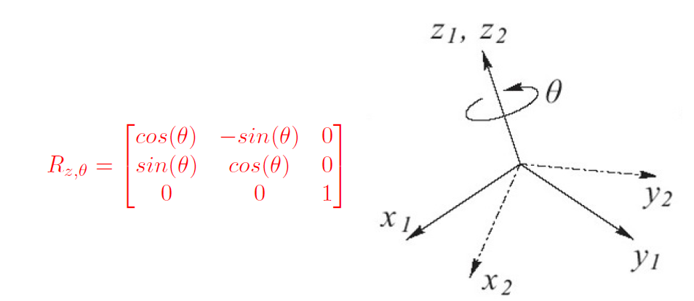
Rotational Transformation

Slide 23
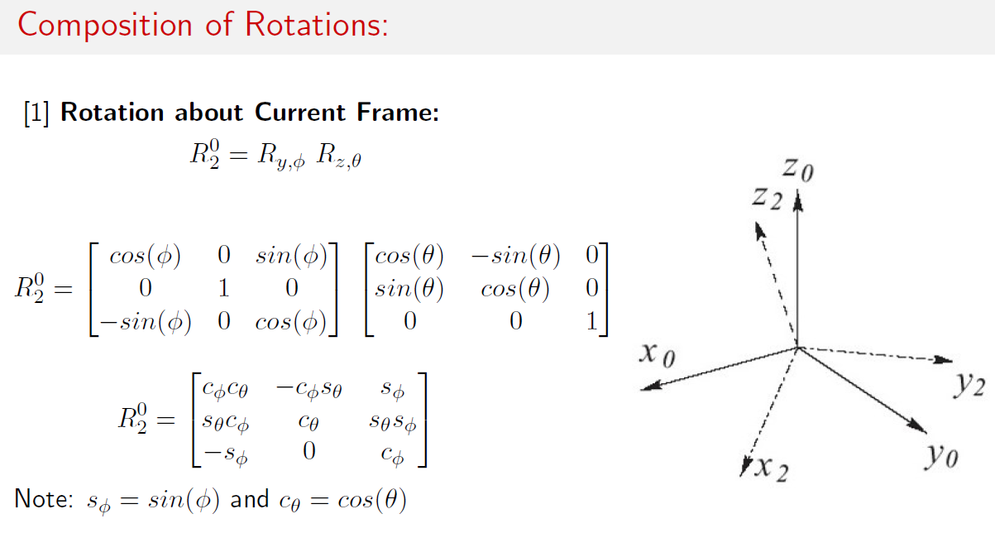
Rotational Transformation

Slide 24
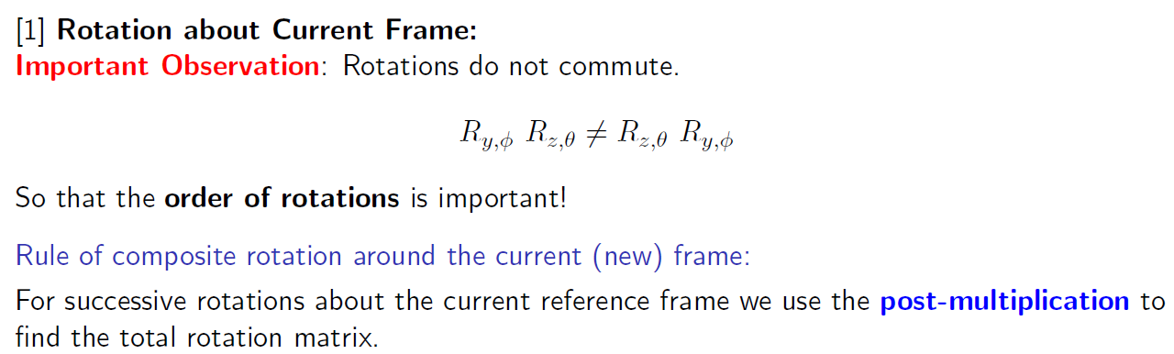
Rotational Transformation

Slide 25
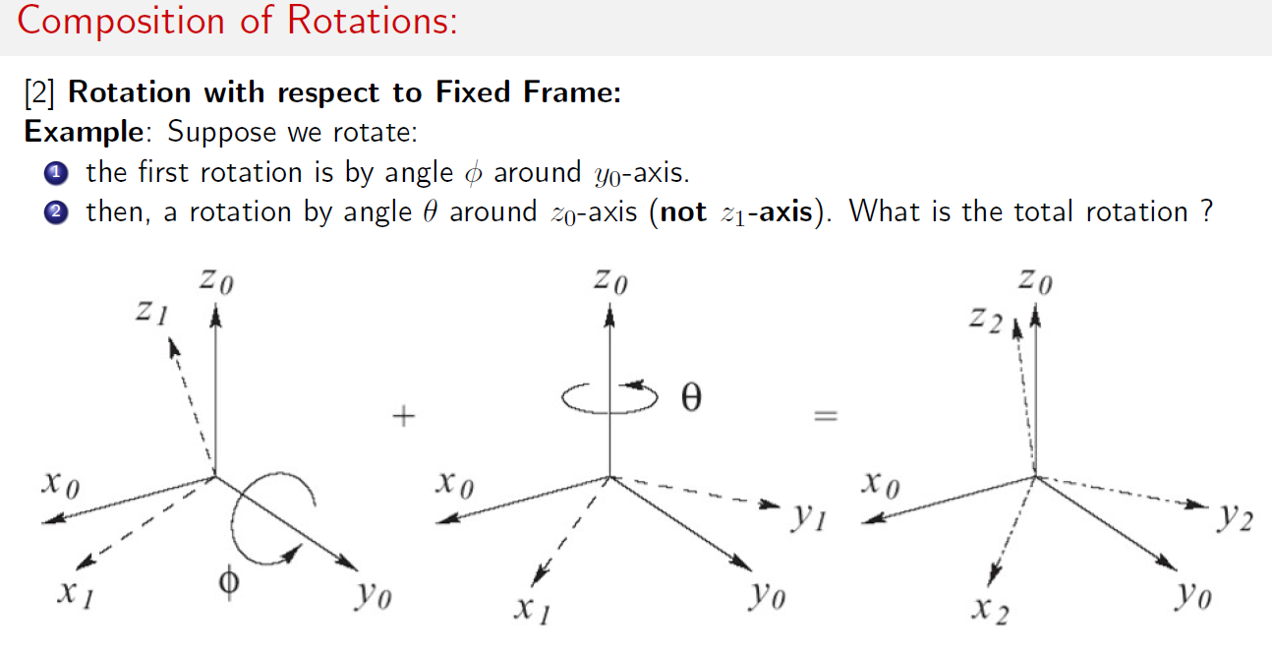
Rotational Transformation

Slide 26
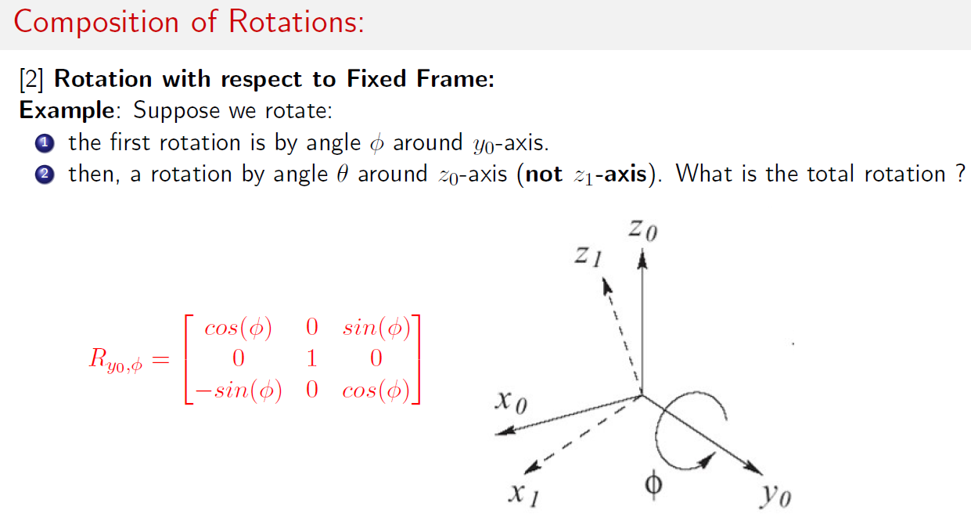
Rotational Transformation

Slide 27
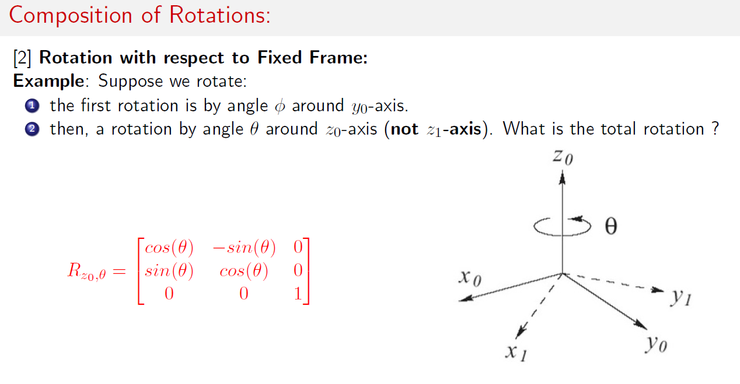
Rotational Transformation

Slide 28
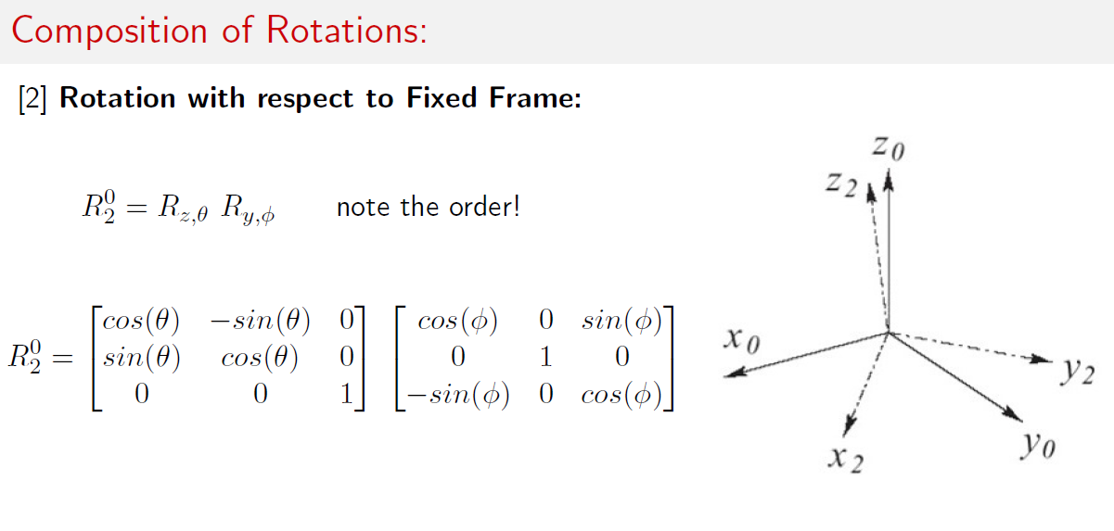
Rotational Transformation

Slide 29
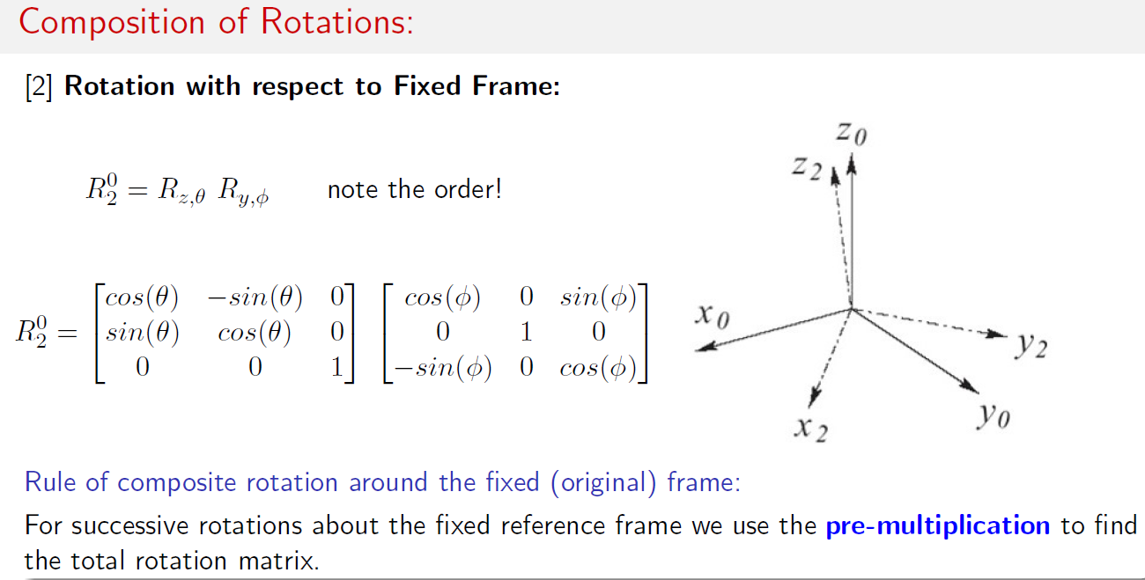
Rotational Transformation

Slide 30
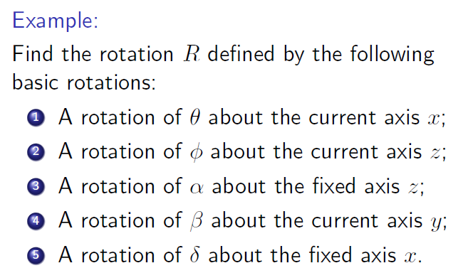

Slide 31
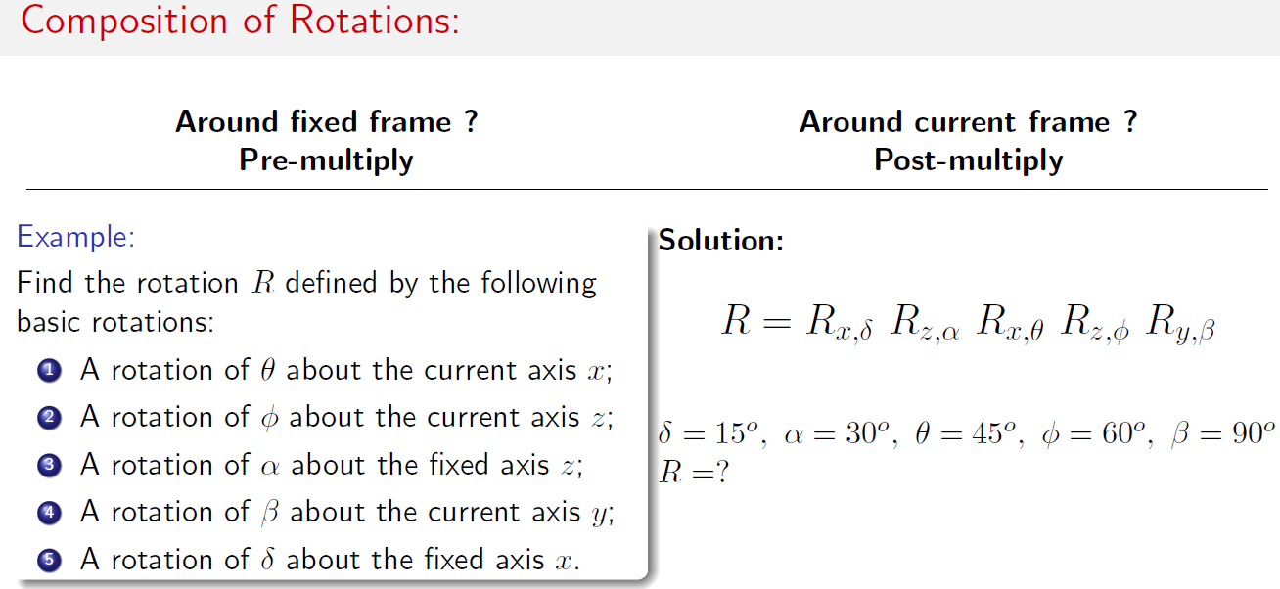

Slide 32
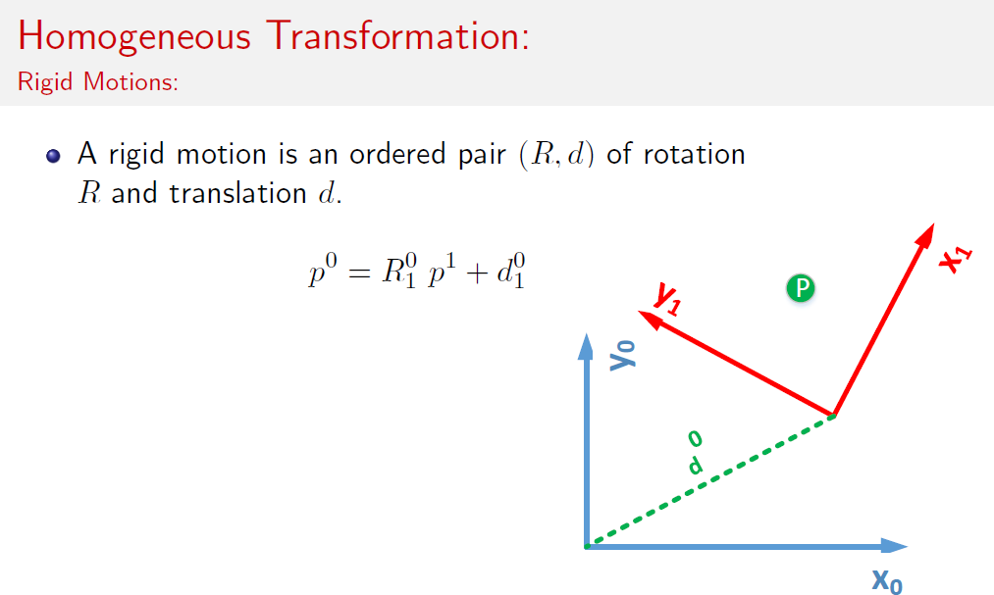
Homogeneous Transformation

Slide 33
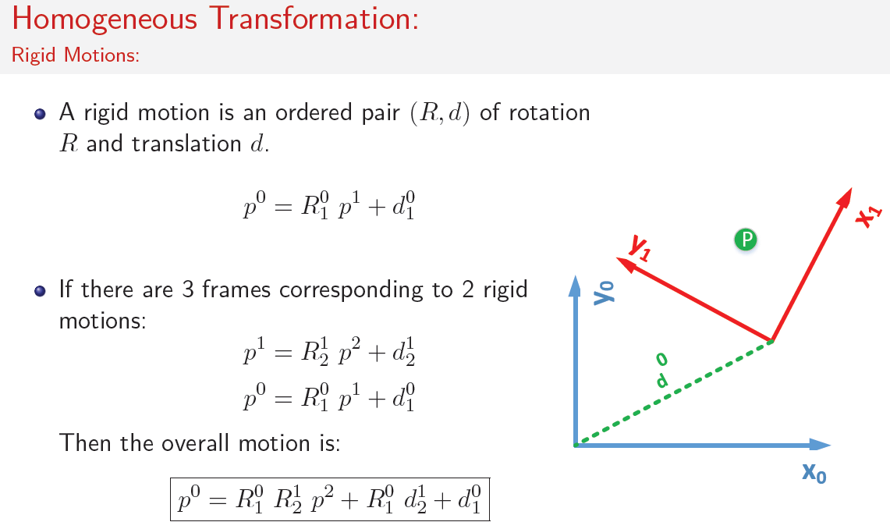
Homogeneous Transformation

Slide 34
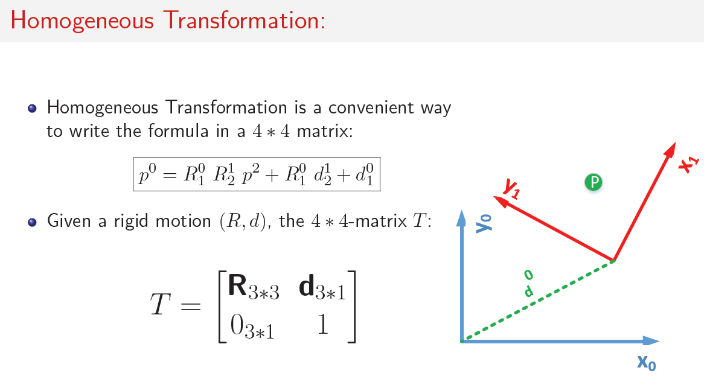
Homogeneous Transformation

Slide 35
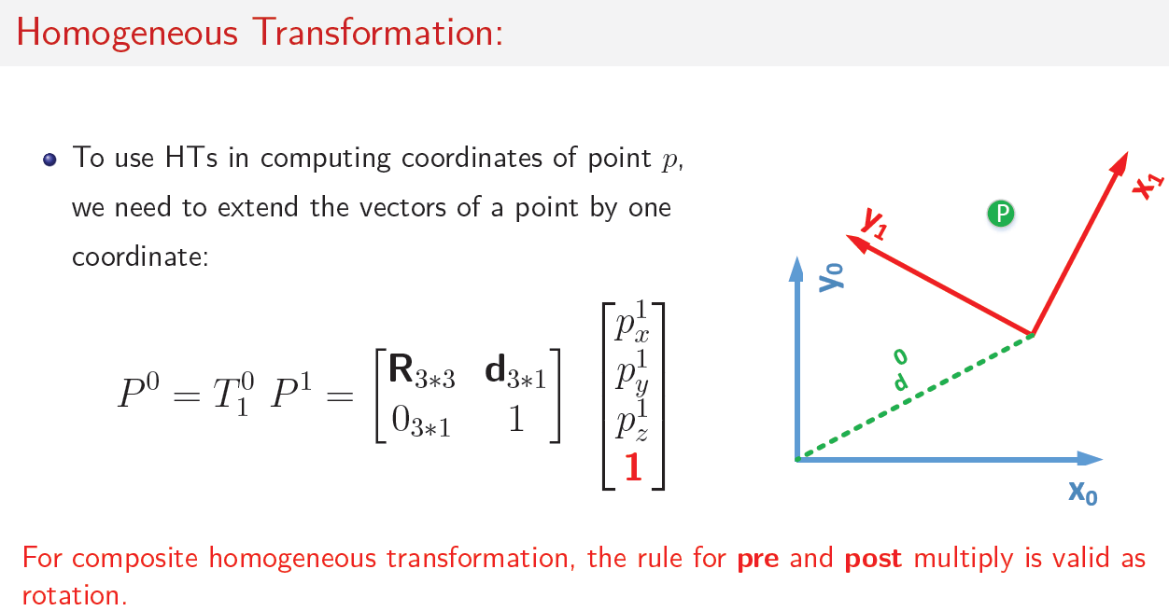
Homogeneous Transformation

Slide 36
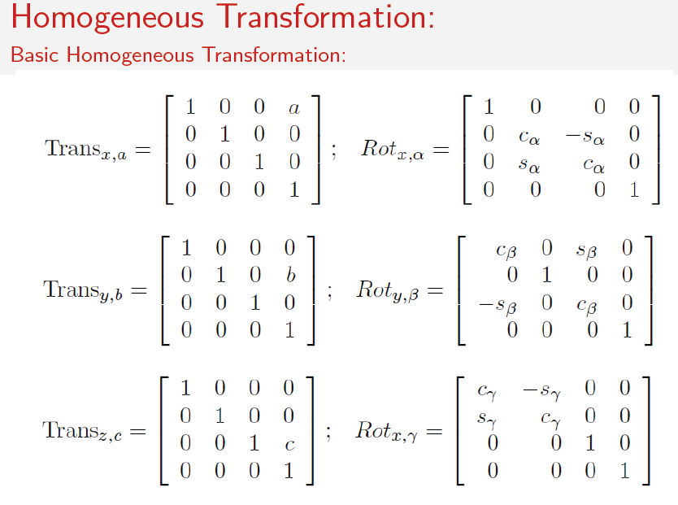

Slide 37
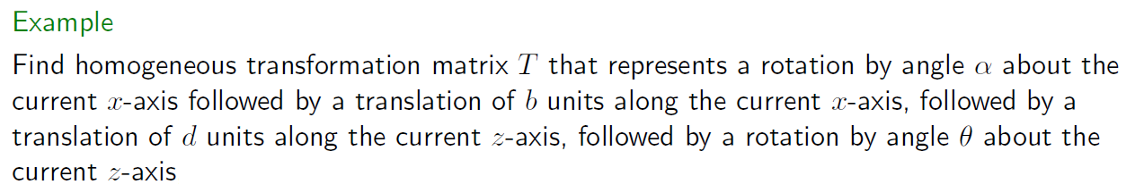
Homogeneous Transformation

Slide 38
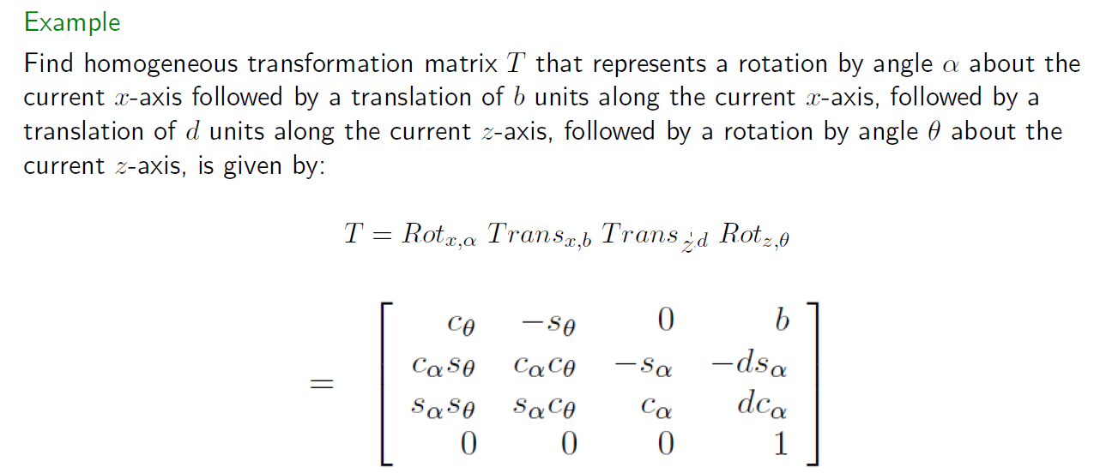
Homogeneous Transformation

Slide 39
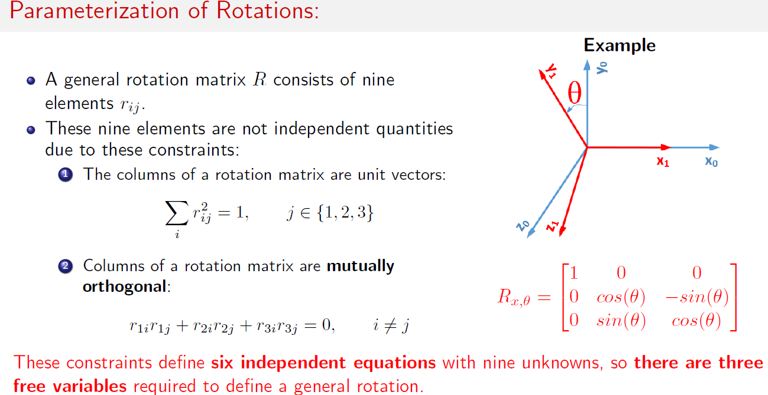
Homogeneous Transformation

Slide 40
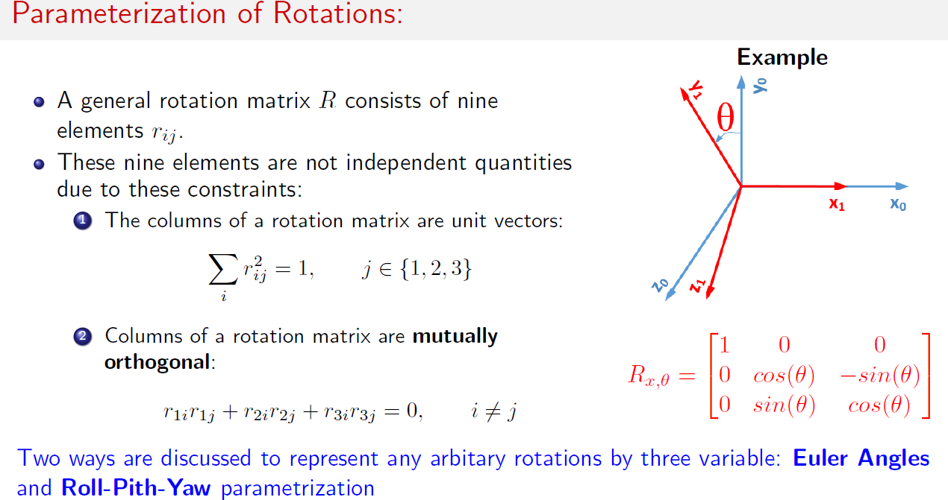
Homogeneous Transformation

Slide 41
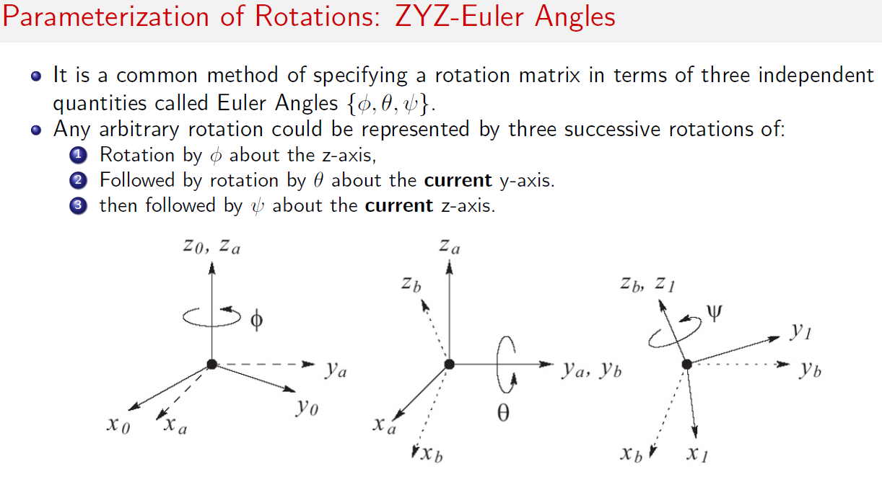
Homogeneous Transformation

Slide 42
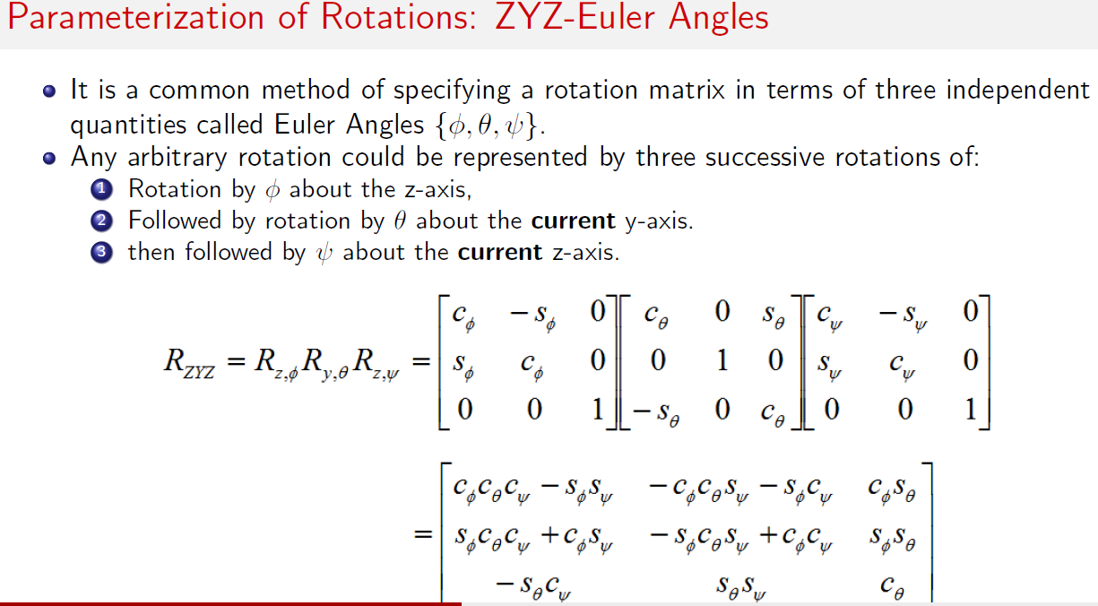
Homogeneous Transformation

Slide 43
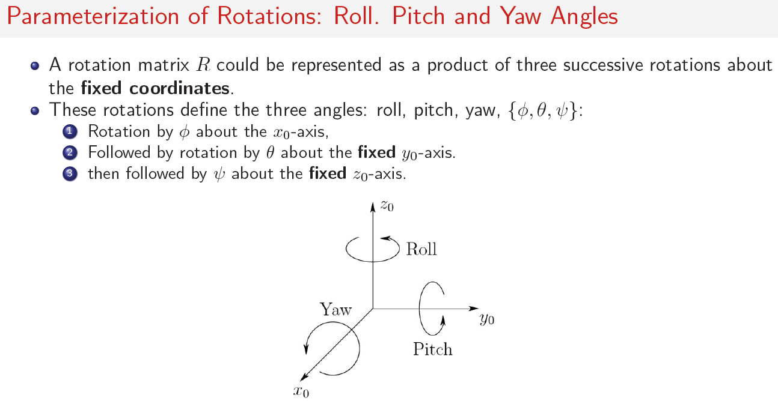
Homogeneous Transformation

Slide 44
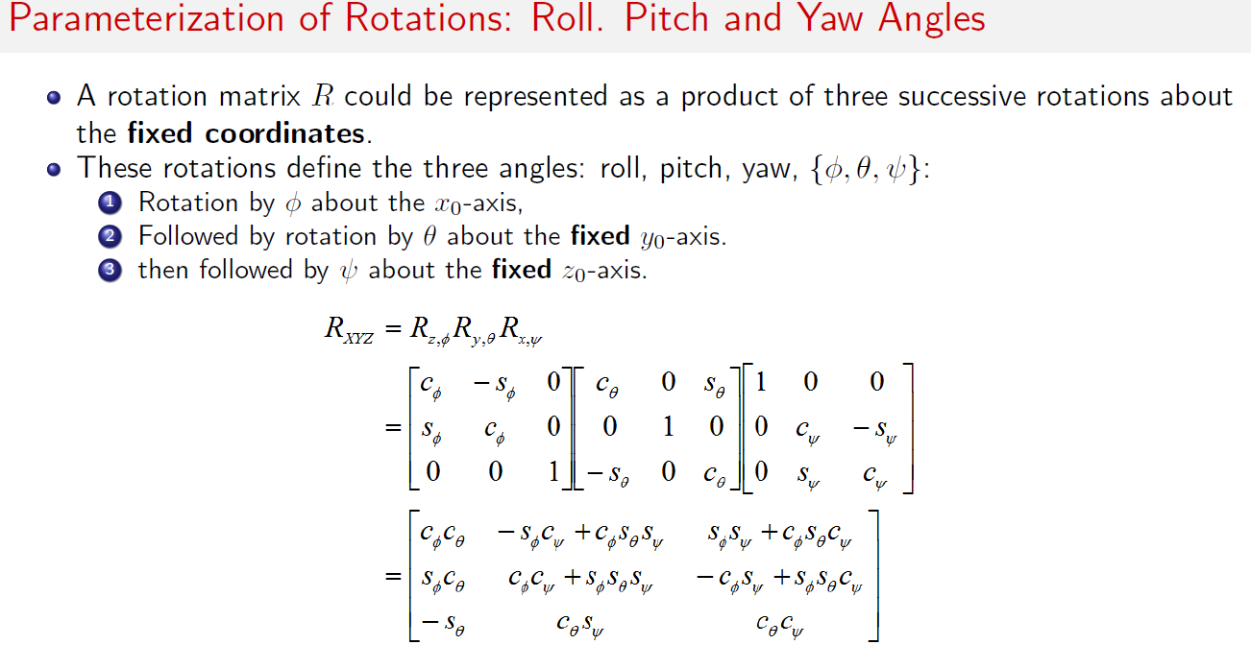
Homogeneous Transformation

Slide 45
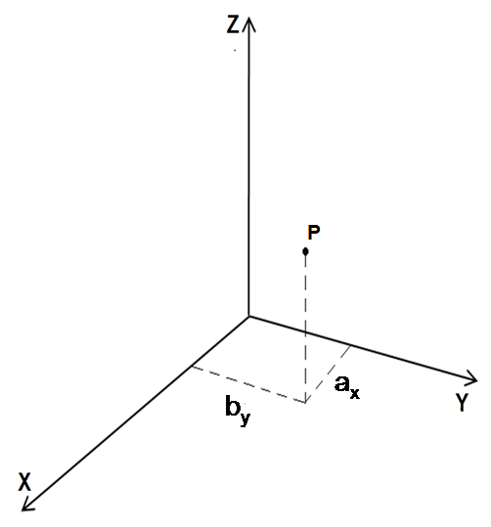
Robot Kinematics
A Point in Space:
A point ‘P’ in space can be represented by its 3 coordinates relative to a reference frame.
Where a_{x,} b_{y} and c_{z} are the 3 coordinates of point represented in the reference frame.
A Vector in Space:
A vector can be represented by 3 coordinates of its tail and head.
C_{z}

Slide 46
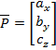
Robot Kinematics
If the vector start at point A and ends at point B, then it can be represented by,
If the vector starts at the origin, then
Where, a_{x}, b_{y}, c_{z} are 3 components of vector in the reference frame in matrix form,
This representation can be modified to also include a scale factor ‘w’ such that
If x,y,z are divided by w they will yield a_{x}, b_{y}, c_{z}

Slide 47
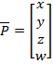
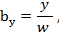
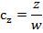
Robot Kinematics
Variable ‘w’ may be any member, and as it changes, it can change the overall size of the vector.
This is similar to zooming a picture in computer graphics.
If w ˃ 1, all vector components enlarge.
If w ˂ 1,all vector components becomes smaller.
If w = 1, size all vector components remain unchanged.
If w = 0, then a_{x,} b_{y} and c_{z} will be infinity i.e. x,y,z will represent a vector where length is infinite, but has direction.
i.e. directional vector can be represented by a scale factor w = 0, where length is not of importance, but direction is represent by 3 components of the vector.
Where,

Slide 48
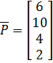
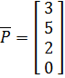
Robot Kinematics
Ex. A vector is described as
Express the vector in matrix form with a scale factor of 2
Express the vector in matrix form if it were to describe a direction as unit vector
The vector can be described in matrix form with a scale factor of 2 as well as 0 for direction as,
and
However, to make it into unit vector, we normalize the length such that new length will equal unity.

Slide 49
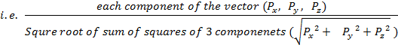
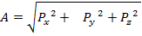
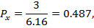
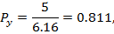
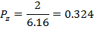

Robot Kinematics

Slide 50

Robot Kinematics
Representation of a Frame at the Origin of Fixed Frame:
A frame centered at the origin of a reference frame is represented by 3 vectors, mutually perpendicular to each other called unit vectors
,ō, ā
for normal vector
ō for orientation vector
ā for approach vector
Each unit vector is represented by
its 3 components in reference frame.
Thus, frame F in matrix is represented as :-
Z
a
o
n
Y
X

Slide 51

Robot Kinematics
Representation of a Frame in A Fixed Reference Frame:
If a frame is not at the origin, then the location of the origin of the frame relative to the reference frame is expressed by 3 vectors describing the directional unit vector as well a forth vector describing its location.
The first three vectors are directional vectors
with w = 0, representing the directions of three
unit vectors of the frame , ō, ā
Z
a
P
o
n
X
Y

Slide 52


Robot Kinematics
While, forth vector with w = 1 represents location of the origin of frame relative to the reference frame unlike unit vectors, length of vector P in important, so we use scale factor w = 1.
Example 2:
The frame is located at 3,5,7 units, with its n-axis is parallel to x axis, its o axis at 45º relative to y axis, it’s a- axis at 45º relative to z- axis.
45º
45º

Slide 53

Robot Kinematics
REPRESENTATION OF A RIGID BODY:
An object can be represented in space by attaching a frame to it and representing the frame in space.
A point in space has 3 d.o.f. (Tx, Ty, Tz)
A Rigid Body in space has 6 d.o.f. (Tx, Ty, Tz, Rx, Ry, Rz)
A frame in space can be represented by a matrix, where the origin of frame, as well as 3 vectors representing the orientation relative to the reference frame
Z
a
o
n
P
Y
X

Slide 54
Robot Kinematics
However, in above matrix, 12 pieces of information are given for orientation, 3 for position. (This excludes the scale factors on the last row of the matrix because they do not add to this information).
There must be some constraints present in this representation to reduce the information from 12 to 6 pieces i.e. 6 constraints.
These 6 Constraints are:
3 unit vectors , ō, ā are mutually perpendicular, their dot product must be zero
• ō = 0, • ā = 0, ā • ō = 0
Each unit vectors length must be equal to unity, i.e. magnitude of the length of vector must be 1.
I n l =1, I o l = 1, l a l = 1

Slide 55

Robot Kinematics
Example 3:
For the following frame, find the values of missing elements and complete the matrix representation of the frame

Slide 56
Robot Kinematics
Values 5,3,2 represent position of the origin of the frame and do not affect constraint equations.
Only three values of directional vectors are given:
O_{y} = 0, n_{y} = 0.707, a_{z} = 0.
n_{x} o_{x} + n_{y} o_{y} + n_{z} o_{z} = 0 or n_{x} (o)+ 0.707 o_{y} + n_{z} o_{z} = 0 or 0.707 o_{y} + n_{z} o_{z} =0
n_{x} a_{x} + n_{y} a_{y} + n_{z} a_{z} = 0 n_{x} (a_{x})+ 0.707 (a_{y})+ n_{z} (0) = 0 n_{x} a_{x} + 0.707 a_{y} = 0
a_{x} o_{x} + a_{y} o_{y} + a_{z} o_{z} = 0 a_{x} (o)+ a_{y} (o_{y})+ 0 (a_{z})= 0 a_{y} o_{y} = 0
n_{x}² + n_{y}² + n_{z}² = 1 n_{x}² + 0.707² + n_{z}² = 1 n_{x}² + n_{z}² = 0.5
o_{x}² + o_{y}² + o_{z}² = 1 o² + o_{y}² + o_{z}² = 1 o_{y}² + o_{z}² = 1
a_{x}² + a_{y}² + a_{Z}² = 1 a_{x}² + a_{y}² + 0² = 1 a_{x}² + a_{y}² = 1

Slide 57


Robot Kinematics
Solving these six equations,
n_{x} = ±0.707, o_{y}= 0, o_{z} +1, a_{x} = ±0.707, a_{y} = 0.707
n_{x} and a_{x} must have same sign, i.e. it is possible to have 2 sets of mutually perpendicular vector in opposite direction, i.e. it is possible to have multiple solutions.
, Or
Values represent by three vector and not arbitrary but bounded by these equations. Do not arbitrary use any desired values in matrix.

Slide 58
Robot Kinematics
Homogeneous transformations:
In robots, both for kinematics (forward and inverse) and for differential motions, we desire square matrices.
To represent both orientation and position in the same matrix. We add scale factors to make it a 4×4 Matrix that is square matrix.
Matrices of this type are called homogeneous matrices.

Slide 59
Robot Kinematics
Homogeneous or square matrices have the following advantages:
Easier to calculate inverse of square Matrix than rectangular matrix.
Multiplication of square matrices becomes easier since dimensions of matrix always match.
(m×m and m×m dimensions)

Slide 60
Robot Kinematics
When a frame (a vector, an object or a moving frame) moves in space relative to a fixed frame, we can represent this motion (change in location and orientation) in a form similar to frame representation.
Transformation maybe:-
Pure translational
Pure rotation about an axis
Combination of translations or rotations

Slide 61

Robot Kinematics
Pure Translation:
If a frame moves in space without any change in orientation, the transformation is pure translational.
In this case, directional unit vectors n̄, ō, ā remain in same direction and do not change.
Where d_{x},d_{y},d_{z} are the 3 components of pure translational vector d relative to x, y, and z axes of the reference frame.

Slide 62





Robot Kinematics
First three columns represent no rotational movement (equivalent to unity) while values in last column represent the translation.
z
$$\overline{a}$$
$$\overline{a}$$
$$\overline{o}$$
p
$$\overline{o}$$
d
$$\overline{n}$$
$$\overline{n}$$
x
y

Slide 63

Robot Kinematics
The new location of the frame relative to the fixed reference frame can be found by adding the vector representing the translation to the vector representing the original location of the origin of the frame.

Slide 64

Robot Kinematics
Example:
A frame F has been moved 9 units along x axis and 5 units along z- axis of the reference frame. Find new location of frame.

Slide 65

Robot Kinematics
Solution:

Slide 66
Robot Kinematics
Pure rotation about an axis:
Assume that frame n̄, ō, ā located at the origin of the reference frame x̅, y̅, z̅ will rotate through an angle 'θ' about the X-Axis of the reference frame.
Assume that attach to the rotating frame n̄, ō, ā is a point P with coordinates P_{x}, P_{y}, P_{z} relative to reference frame and P_{n}, P_{o} and P_{a} relative to the moving frame.
As the frame rotates about X-Axis point be attached to the frame will also rotate with it.
Before rotation coordinates of point 'P' in both reference and n̄, ō, ā and x̅, y̅, z̅ are the same. (Both frames are at the same location in (same-origin) and parallel to each other).

Slide 67
Robot Kinematics
After rotation P_{n}, P_{o} and P_{a} co-ordinates of the point remains same in its own face n̄, ō, ā. But P_{x}, P_{y}, P_{z} co-ordinates will be different in x̅, y̅, z̅ frame.
Find the new co-ordinates of the point relative to the fix reference frame after the moving frame has rotated.
Z
Z
P
P
θ
a
a
o
o
P_{z}
θ
n
n
P_{z}
X
P_{y}
P_{y}
P_{x}
P_{x}
X
Before Rotation

Slide 68
Robot Kinematics
z
a
P
o
L₃
P_{a}
P_{z}
L₄
P_{a}
P_{o}
y
P_{y}
L₂
L₁

Slide 69


Robot Kinematics
P_{x} does not change as the frame rotates about the x axis but the values of P_{y} and P_{z} do change.
Indicated coordinates along X axis have not change

Slide 70

Robot Kinematics
The coordinates of point (or vector) P in the rotated frame must be pre-multiplied by rotation matrix, to get coordinates in reference frame.
This rotation is about x-axis of the reference frame and is denoted as

Slide 71

Robot Kinematics
i.e. ^{U}T_{R} = Transformation of frame relative to frame U for universe
P_{noa} as ^{R}P- P relative to frame R
P_{xyz} as ^{U}P- P relative to frame U
Cancelling R gives coordinates of point P relative to U.

Slide 72
Robot Kinematics
Example:
A point P (2, 3, 4) is attached to a rotating frame the frame rotates 90°about X-Axis of the reference frame. Find out the coordinates of the point relative to the reference frame after the rotation.

Slide 73


Slide 74
Combined Transformation
Combined transformations consist of a number of successive translations and rotations about:
the fixed reference frame axis or
the moving current frame axis.
Assume a frame n̄, ō, ā assume a frame an a subjected to following three transformations relative to the fixed reference frame x,y,z.
Rotation of α degrees about x axis.
Followed by translation of (L₁,L₂,L₃) relative to x,y,z axis
Followed by a rotation of β degrees about y axis.
Point P_{noa} is attached to the rotating frame at the origin of the reference frame.
P_{1,xyz} =Rot(x,α) X P_{noa}
Where P_{1,xyz} is the coordinate of the point after the first transformation relative to the reference frame .

Slide 75
Combined Transformation
The coordinates of the point relative to the reference frame at the conclusion of the second transformation will be
P_{2,xyz} =Trans(L₁,L₂,L₃) X P_{1,xyz} = Trans(L₁,L₂,L₃) X Rot(x,α) X P_{noa}
similarly after third transformation, the coordinates of the point relative to reference frame will be
P_{xyz} = P_{3,xyz} = Rot(y,β) X P_{2,xyz}
= Rot(y,β) X Trans(L₁,L₂,L₃) X Rot(x,α) X P_{noa}
The coordinates of the point relative to the reference frame at the conclusion of each transformation is found by pre-multiplying the coordinates of the point by each transformation matrix.
Thus, the order of matrices written is the opposite of the order of transformation performed.

Slide 76
Combined Transformation
Ex.
A point P(7,3,2) is attached to the frame n̄, ō, ā and is subjected to the following transformations.
Rotation of 90º about the z-axis
Followed by a rotation of 90º about the y-axis
Followed by a translation of (4,-3,7)
Find the coordinates of the point relative to the reference frame at the conclusions of the transformations.
Solution:
P_{xyz} = Trans(4,-3,7) X Rot(y,90º) X Rot(z, 90º) X P_{noa}

Slide 77


Combined Transformation
Solution:
P_{xyz} = Trans(4,-3,7) X Rot(y,90º) X Rot(z, 90º) X P_{noa}

Slide 78
Combined Transformation
Ex.
A point P(7,3,2) is attached to the frame n̄, ō, ā and is subjected to the following transformations but in different order i.e.
Rotation of 90º about the z- axis
Followed by a translation of (4,-3,7)
Followed by a rotation of 90º about the y axis, then
Find the coordinates of the point relative to the reference frame at the conclusions of the transformations.
Solution:
P_{xyz} = Rot(Y,90º) × Trans(4,-3,7) × Rot(Z, 90º) × P_{noa}

Slide 79


Combined Transformation
Solution:
P_{xyz} = Rot(y,90º) X Trans(4,-3,7) X Rot(z, 90º) X P_{noa}

Slide 80




Combined Transformation
Ex. A moving frame noa is obtained from frame xyz by rotation of 90º about the z axis followed by a rotation of 90º about the x axis. Then, noa locates a point P_{noa} at n=10, o=20 and a=30. Determine its coordinates with respect to reference frame xyz.
Solution:
P_{xyz} = Rot(x,90º) X Rot(z, 90º) X P_{noa}
Rot(x,z)= Rot(x,90º) X Rot(z, 90º)

Slide 81

Combined Transformation
Z a
Z n
o
20
Z
a
30
Y
10
o
o
Y n
Y
X
P
X
X
n
a
Initial position
After Rot(x , 90˚)
(The second rotation)
Final position
After Rot (z, 90˚)
(The first rotation)

Slide 82




Combined Transformation
P_{xyz}
P_{xyz}

Slide 83
Combined Transformation
Z a
Z n
o
20
Z
a
30
Y
10
o
o
Y n
Y
X
P
X
X
n
a
Initial position
After Rot(x , 90˚)
(The second rotation)
Final position
After Rot (z, 90˚)
(The first rotation)

Slide 84

Combined Transformation
Ex.A moving frame noa is obtained from frame xyz by rotation of 90º about the z axis followed by a rotation of 90º about the n-axis. Then, noa locates a point P_{noa} at n=10, o=20 and a=30. Determine its coordinates with respect to reference frame xyz.
Solution:
P_{xyz} = Rot(z,90º) X Rot(n, 90º) X P_{noa}
Rot(z,n)= Rot(z,90º) X Rot(n, 90º)

Slide 85

Combined Transformation
Z a
Z O
Z
a
30
o
Y V
Y n
Y
o
20
X
10
X
n
X a
After Rot(x , 90˚)
(The second rotation)
Final position
Initial position
After Rot(z, 90˚)
(The first rotation)

Slide 86




Combined Transformation
P_{xyz}
P_{xyz}

Slide 87
Combined Transformation
Z a
Z O
Z
a
30
o
Y V
Y n
Y
o
20
X
10
X
n
X a
After Rot(x , 90˚)
(The second rotation)
Final position
Initial position
After Rot(z, 90˚)
(The first rotation)

Slide 88
Combined Transformation
Transformation relative to rotating frame:
It is possible to make a transformation relative to the axis of a moving or current frame.
i.e. A rotation of 90º be made relative to n̄ axis of the moving or current frame and not the x- axis of the reference frame.
To do this, transformation matrix is post-multiplied, Since the position of a point or an object attached to a moving frame is always measured relative to that moving frame, the position matrix describing the point or object is also always post multiplied.

Slide 89
Combined Transformation
Ex.8
The same point P(7,3,2) is subjected to transformations relative to the current moving frame, find the coordinates of the point relative to the reference frame after the transformations are completed.
Rotation of 90º about the ā axis
Then a Followed by a translation of (4,-3,7) along n̄, ō, ā
Followed by a rotation of 90º about the ō axis.
Solution:
P_{xyz} = Rot(ā ,90º) X Trans(4,-3,7) X Rot(ō, 90º) X P_{noa}

Slide 90


Combined Transformation
Solution:
P_{xyz} = Rot(ā ,90º) X Trans(4,-3,7) X Rot(ō, 90º) X P_{noa}

Slide 91
Combined Transformation
Ex.9
A frame B, was rotated about the n̄ axis 90º,it was then translated about the current ā axis 3mm before being rotated about the z-axis 90º. Finally it was translated about the current ō axis 5mm
Write a equation describing the motion
Find the final location of a point P(1,5,4) attached to the frame relative to the reference frame.
Solution:
^{U}T _{B}= Rot( z,90º) X Rot(n̄ ,90º ) X Trans(0,0,3) X Trans(0,5,0)

Slide 92


Combined Transformation
Solution:
^{U}T _{B}= Rot( z,90º) X Rot(n̄ ,90º ) X Trans(0,0,3) X Trans(0,5,0)
^{U}P= ^{U}T _{B} X ^{B}P

